Slide 1
Heterogeneous Computing for Smart and Energy-efficient Mobile Applications
Ting-Chang Huang
Senior Engineer
Computing Platform Technology Division in CTO
MediaTek, Inc.
emerson.huang@mediatek.com
May 4, 2015 – NTHU, HsinChu

Slide 2
Symmetric Computing
Asymmetric Computing
Heterogeneous Computing
Symmetric Computing
Asymmetric Computing
Heterogeneous Computing
Symmetric Computing
Asymmetric Computing
Heterogeneous Computing
Power Consumption
Big Core
Serial Computing
Little Core
Household Applications
Heavy-load Tasks
Light-load Tasks
GPU
Intensive Computing
Big Core
Serial Computing
Little Core
Household Applications
Parallel Algorithms
Heavy-load Tasks
Light-load Tasks
Little Core
Household Applications
Light-load Tasks
Big Core
GPU
Little Core
Performance
(MIPS)
Notes:
change@0417:
Change color of GPU to green

Slide 3
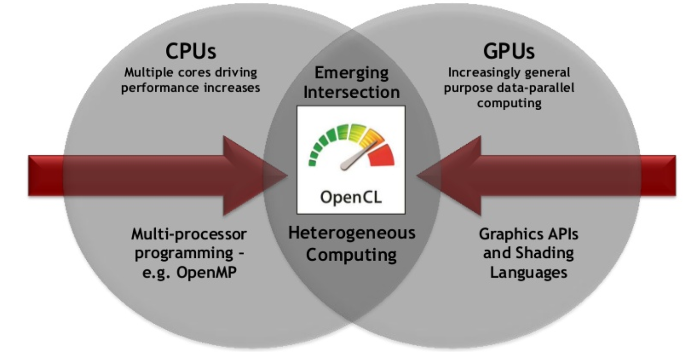
Heterogeneous computing and OpenCL
OpenCL supports functional portability
OpenCL doss not guarantee performance portability

Slide 4
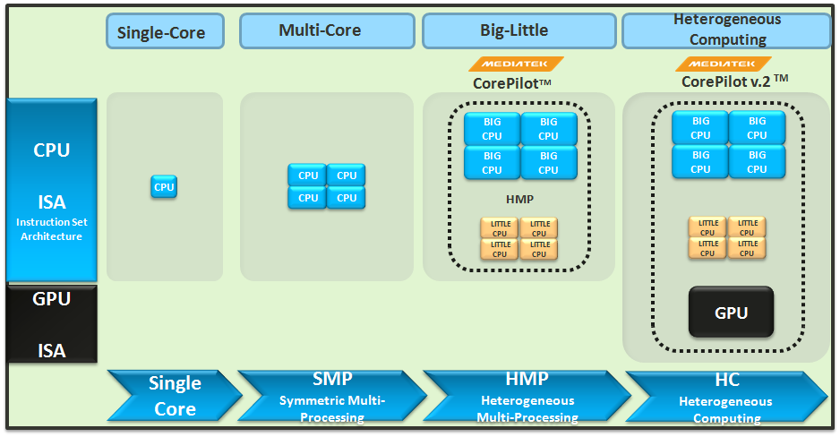
Evolution of MediaTek CorePilot
Motivation
Challenge
Solution
Conclusion
Achievements
Task Scheduler
Interactive Power Management
Adaptive Thermal Management
Presented at Linley Mobile Conf’14
2.0
Task Scheduler
Interactive Power Management
Adaptive Thermal Management
Device Fusion
Notes:
CHANGE@0417:
enlarge the dialog boxs

Slide 5
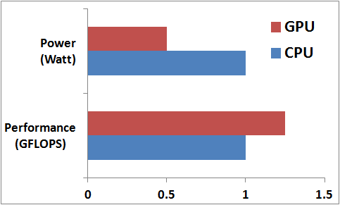
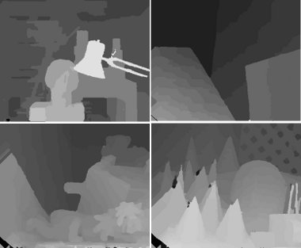
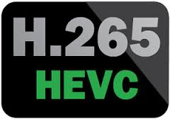
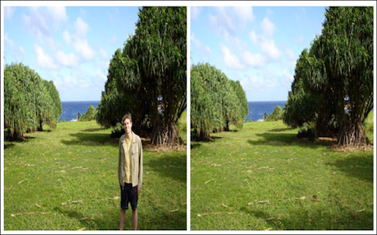
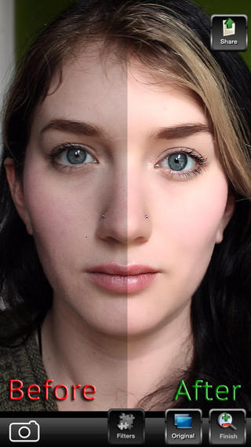
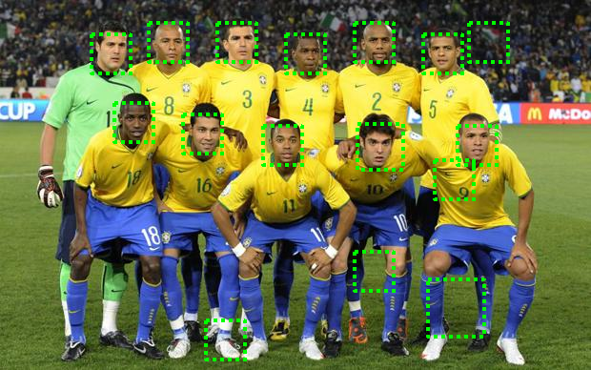
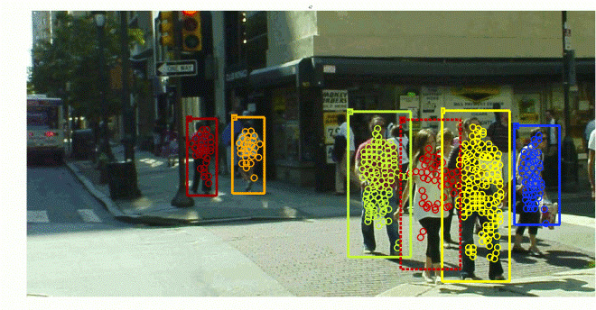
Benefits of GPU Computing
Motivation
Challenge
Solution
Conclusion
Achievements
peak power and performance of MT6795
-50%
Higher performance
Lower power consumption
Mobile applications:
  Computer vision
  Image processing
  Video acceleration
  Cognitive computing
+25%
H.265 decoder acceleration
stereo matching
object removal
face beautification
face detection
pedestrian detection
Notes:
Image processing: object removal / face beautification
Computer vision: pedestrian/face detection, stereo matching (build 3D model from 2D pictures)
Video acceleration: H.265 decoder acceleration,
CHANGE@0417:
Align the image border
Typo correction

Slide 6
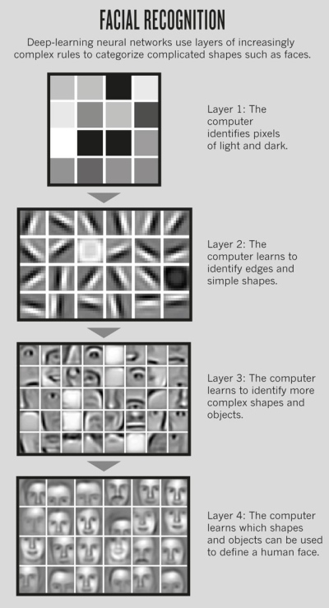
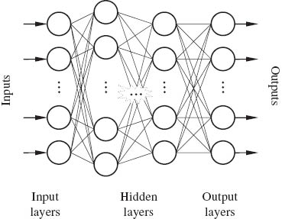
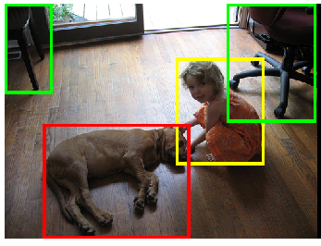
Computation Intensive Applications:
Deep Learning
Motivation
Challenge
Solution
Conclusion
Achievements
Image
Voice
Data
Layer 1.
Pixels features
Input Layer
Layer 2.
Edges and
Simple shapes
Hidden Layers
Layer 3.
Complex shapes
Output Layer
Layer 4.
Object Models
http://goo.gl/jO6L20
Notes:
Why “Voice” as an input?
What’s the difference between “Image” and “Data”

Slide 7
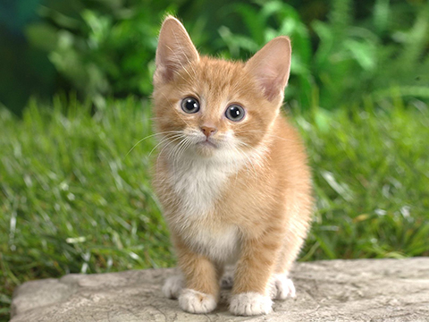
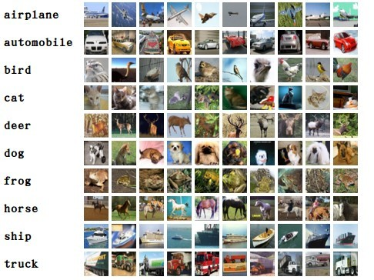
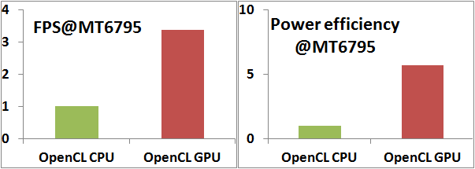
Deep Learning in Object Recognition
Motivation
Challenge
Solution
Conclusion
Achievements
AlexNet (based on ImageNet dataset)
hidden layers
Recognize
1000 objects
Large amount of computation overwhelms CPU.
Normalized value
Notes:
FPS Power Power efficiency
Eigen CPU 0.98 2.98 0.33
OpenCL CPU 1.64 4.24 0.39
OpenCL GPU 5.54 2.48 2.23
change@0417:
1. Scales in FPS and power efficiency figures are changed as normalized value
2. Remove of ILSVRC’12 , and Add “(based on ImageNet dataset)”

Slide 8
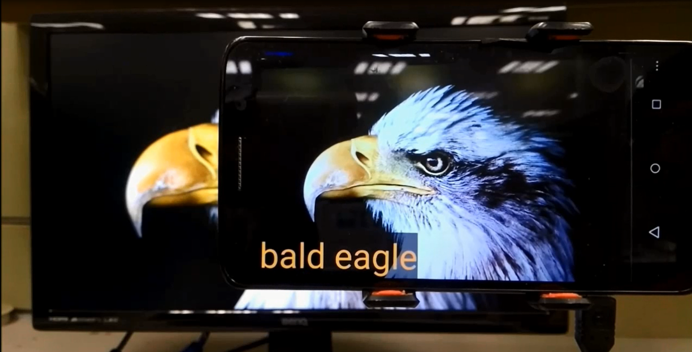
Deep Learning Demo on MT6795 GPU
Motivation
Challenge
Solution
Conclusion
Achievements
Notes:
change@0417:
Add “on MT6795 GPU”

Slide 9
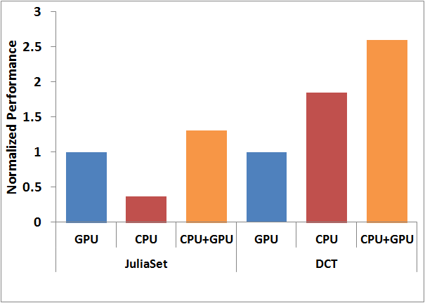
Sticking to One isn’t Always the Best
Motivation
Challenge
Solution
Conclusion
Achievements
GPU > CPU
GPU < CPU
Utilizing CPU+GPU outperforms single devices
A need of portable programming APIs across devices
Notes:
change@0417:
Add animation for CPU+GPU
Description of JuliaSet “a mathematic fractal computing workload”

Slide 10
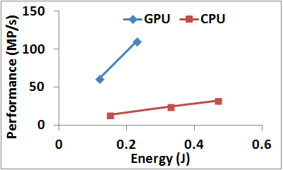
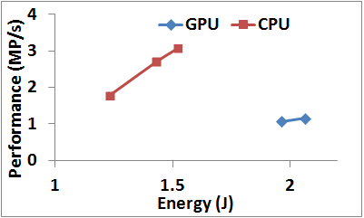
Not all programs run well on GPU
Currently, programmers determine a program being executed at CPU or GPU
However, programmers usually cannot determine the suitable device, leading to…
  lower performance
  higher energy consumption
JuliaSet ➔ suitable for GPU
ViolaJones ➔ suitable for CPU

Slide 11
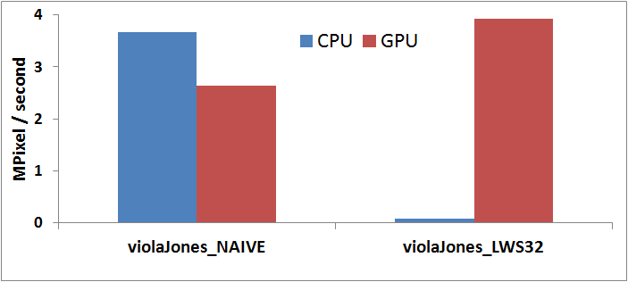
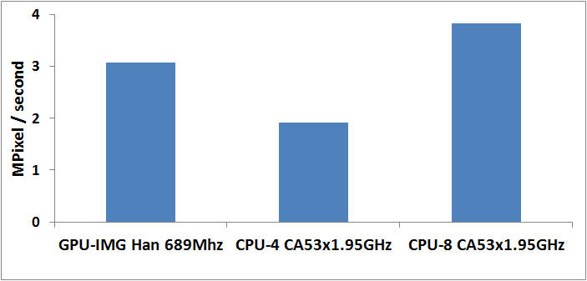
WHY some programs performs slower on GPU?
  Program affinity varies with the implementation
  Different device computing capability
Factors which affect affinity:
number of TLP
divergence
barrier
memory access pattern
……
find_neighbor in Super Resolution
Factors which computing capability:
Hardware configuration
Thermal limitation
Different GPU architectures
……

Slide 12
Heterogeneous Computing Product Release
Motivation
Challenge
Solution
Conclusion
Achievements
 | 2014 | 2015
OpenCL 1.2 GPU
OpenCL 1.2 CPU
OpenCL 1.2 Device Fusion
MT6595/IMG 6XT
MT6795/IMG 6XT
MT6795/CA53x8
MT6795/CA53x8, IMG 6XT (CPU+GPU)
OpenCL Programs
OpenCL is an industry standard programming API for heterogeneous computing.
Device Fusion
Efficiently execute OpenCL programs by fusing GPU and CPU computing capability.
Key addition to CorePilot 2.0
CPU
GPU
CPU and GPU devices are the pillars and also available standalone.
Notes:
OCL 2.0 : (1) Unified share virtual memory and (2) fully coherency => high efficient data movement between CPU & GPU clusters
change@0417:
Lowlight the description block of “OpenCL….” and “CPU and GPU …” due to Barz’s comments

Slide 13
Device Fusion
Efficiently execute OpenCL programs by fusing GPU and CPU computing capability
Throughput-oriented OpenCL Program
GPU-preferred OpenCL Program
CPU-preferred OpenCL Program
Device Fusion
Device Fusion
Device Fusion
CPU
GPU
CPU
GPU
CPU
GPU
single-device execution
parallel execution

Slide 14
Architecture Overview of Device Fusion
Motivation
Challenge
Solution
Conclusion
Achievements
OpenCL Programs
OpenCL API Wrapper & Dispatcher
Provide user-friendly transparency to hide implementation detail
Device Fusion
OpenCL API Wrapper
Profiler
Collect app dynamic behaviors and underlying system and device info
Profiler
Parallel Infrastructure
Dispatch Policy Maker
Dispatch Policy Maker
Make intelligent decisions to dispatch based on profiling information
Dispatcher
CPU
GPU
Parallel Infrastructure
Automate data partitioning and synchronizations for parallel execution
Notes:
change@0417:
Change the color of description blocks according to Barz’s comments

Slide 15
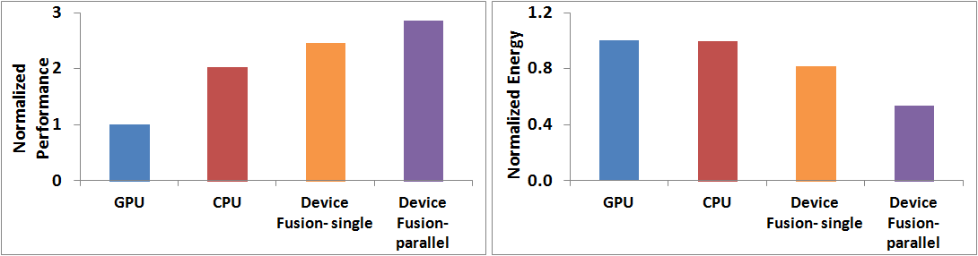
Case Study: Face Detection
Motivation
Challenge
Solution
Conclusion
Achievements
Execution Flow
CPU
GPU
CPU
GPU
CreateIntensity
IntegralStep1
Transpose
IntegralStep2
CPU
ViolaJones
Transpose
CPU + GPU
(parallel)
CPU
+186% to GPU
+42% to CPU
+146% to GPU
+22% to CPU
-17% to GPU
-18% to CPU
-45% to GPU
-46% to CPU
Notes:
change@0417:
Change the description “CPU+GPU” → “CPU+GPU (parallel)”
Change the color of block “CPU+GPU (parallel)”
Correct the type “normalized”

Slide 16
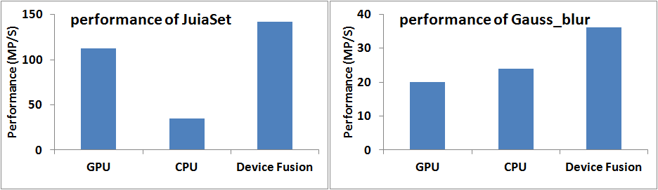
Usage scenarios and case studies – parallel execution
For a kernel, enable parallel execution of both CPU and GPU
Scenario: throughput-oriented kernel
64% jobs at GPU
36% jobs at CPU
40% jobs at GPU
60% jobs at CPU

Slide 17
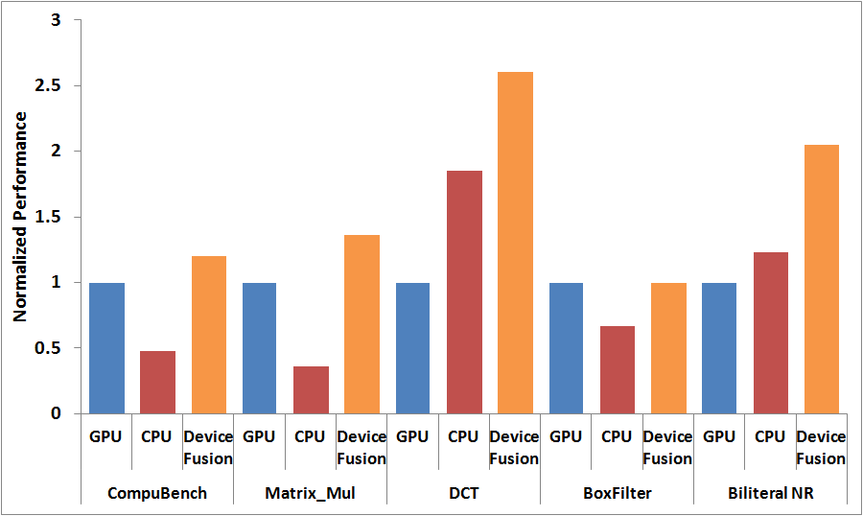
Performance of Device Fusion
Motivation
Challenge
Solution
Conclusion
Achievements
Measured on MT6795
Notes:
Compubench: Professional OpenCL benchmark
Matrix_Mul: GPU-favored workload
DCT: CPU-favored workload
Boxfilter: unable to be parallel executed, choose the device with better performance (i.e. GPU)
Biliteral NR: good case for parallel execution since similar CPU/GPU capability

Slide 18
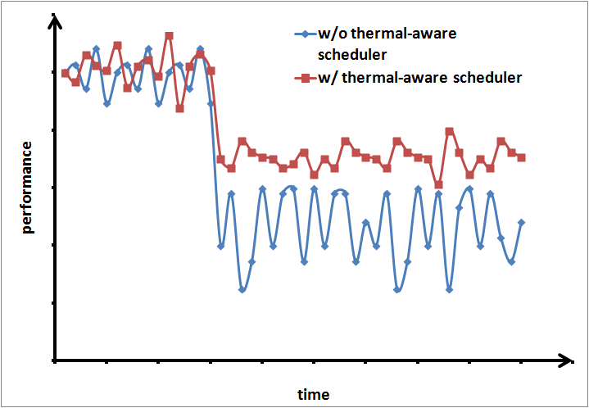
Thermal-aware Scheduler
Motivation
Challenge
Solution
Conclusion
Achievements
Overheating slows down the SoC speed, leading to dramatic and un-predictable performance drops
Thermal-aware scheduler reduces performance drops
Re-dispatching jobs to a device with better power-efficiency
Lowering DVFS
overheating

Slide 19
Thermal-aware scheduler
Reduce the parallelism when temperature is high
When thermal condition deteriorates, reduce the parallelism step-by-step to mitigate the hotspot
hot
Force ratio as 1.0 (all GPU)
Try to mitigate the hotspot by parallelism reduction
Temp. threshold 0
Force ratio as 1.0 (all GPU) or 0.0 (all CPU)
Temp. threshold 1
Reducing CPU load to relax the thermal condition
ratio is automatically changed due to CPU throttling
Temp. threshold 2
Use learned ratio
cool

Slide 20
Performance is only topic in heterogeneous computing?

Slide 21
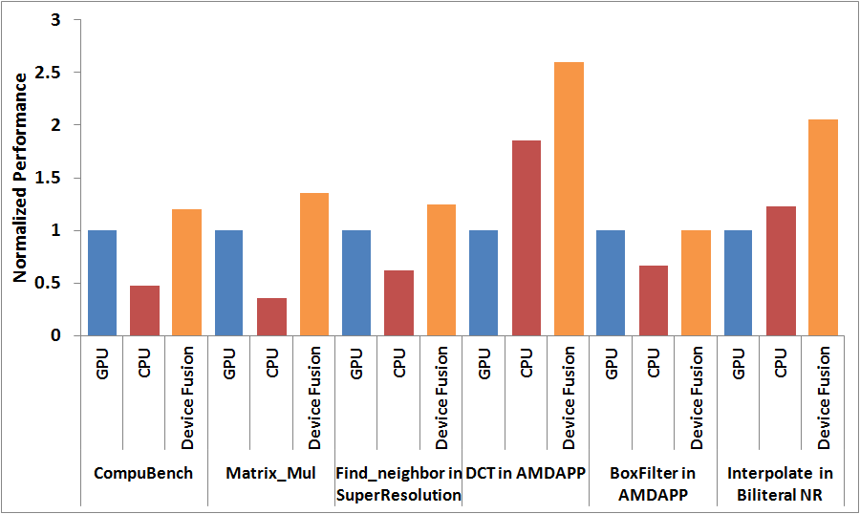
Performance of Device Fusion (performance mode)
Perf + 25%
Pow+ 283%
Perf + 40%
Pow+ 34%
5.5W
4.1W
4.6W
1.2W
1.5W
3.4W

Slide 22
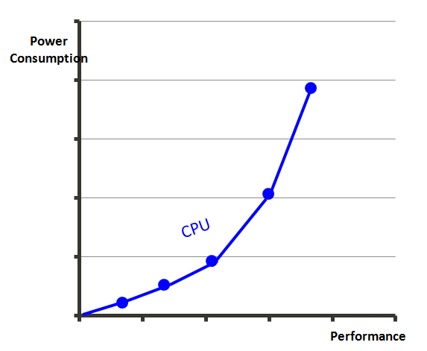
Power-aware scheduling in Device Fusion
power constraint
best performance
lowest power
GPU
Performance requirement

Slide 23
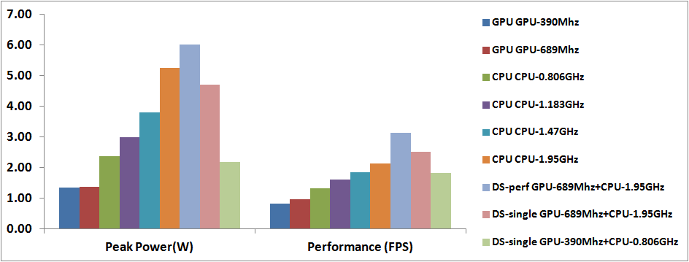
Face detection: peak power and performance under different CPU/GPU configurations
Use GPU @689MHz
Use CPU@1.183GHz
power budget = 1.5W
power budget = 3W

Slide 24
Face detection: peak power and performance under different CPU/GPU configurations
use this configuration
performance constraint = 1.2FPS

Slide 25
Using power-aware scheduling under Face detection

Slide 26
Using power-aware scheduling under Face detection

Slide 27
Motivation
Challenge
Solution
Conclusion
Achievements
MediaTek CorePilot 2.0
1st Mobile OpenCL Device Fusion | Introduced the first mobile OpenCL Device Fusion into production in January, 2015
Extending Technology Leadership | Advance the performance, power, and thermal management techniques in CorePilot into the extended framework in CorePilot 2.0.
Outstanding Performance | 20% performance uplift in the CompuBenchCL benchmark by using Device Fusion
Enhancing User Experiences | Complete OpenCL solutions on CPU and GPU to enable smart and energy-efficient mobile applications

Slide 28

Summer Intern/part-time employee/Permanent employee

Slide 30
MT6795
 | MT6795
Schedule | MP 2015/1
Android OS | Android L 5.0
CPU | CA53 Octa-Core up to 2.2 GHz
Graphic | IMG G6200 700MHz
Memory | Dual-channel LPDDR3 933MHz

